Slide 1
Rock Eagle 4-H
Environmental Education
Where education comes alive.

Slide 2
Rock Eagle is a part of UGA.

Slide 3
Location: Eatonton, GA
Located in Georgia’s Piedmont.
Adjacent to Oconee National Forest.
1,428 acres of forested land, including a 110 acre lake.
Namesake: Rock Eagle Effigy estimated over 500 years old!

Slide 4
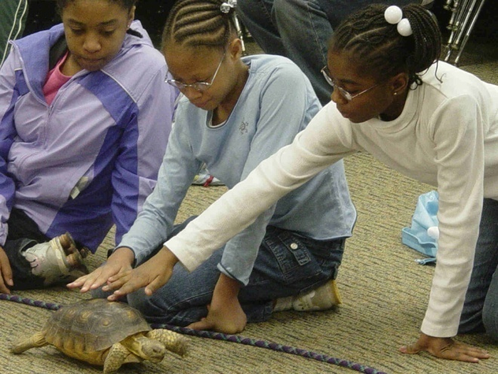
Program History
Georgia 4-H Environmental Education started in 1979 at Rock Eagle.
Expand classroom walls to include local natural environment for hands-on, inquiry based, real-world learning.
Correlated to current state standards (GPS).
Classes offered in Ecology, Team Building, Living History, and Outdoor Skills.

Slide 5
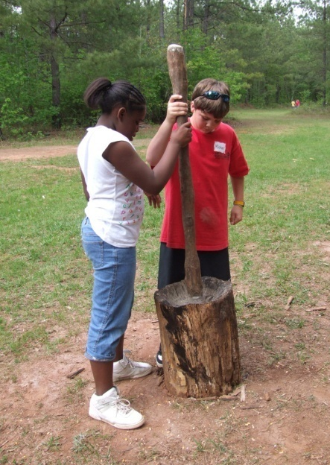
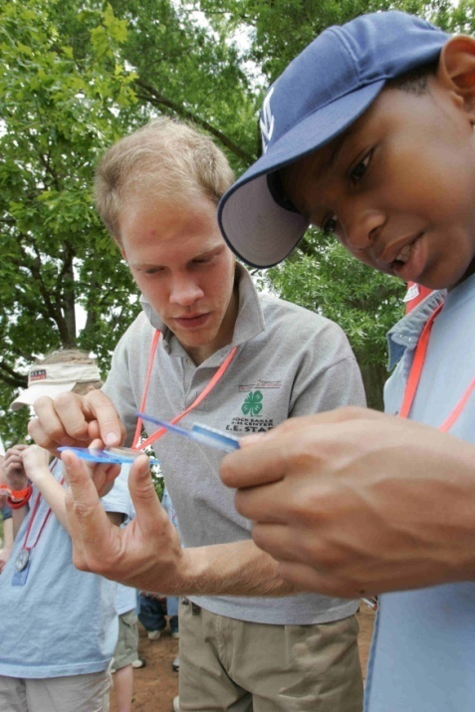
Day Classes
Team Building
Team Initiatives
Challenge Courses
High Ropes
Outdoor Skills
Canoeing
Orienteering
Ecology
Forest Ecology & Management
Herpetology
Lake Ecology & Assessment
Ornithology
Watershed Studies
Living History
Native American Studies
Pioneer Tools
Pioneer Life
Rock Eagle Hike

Slide 6
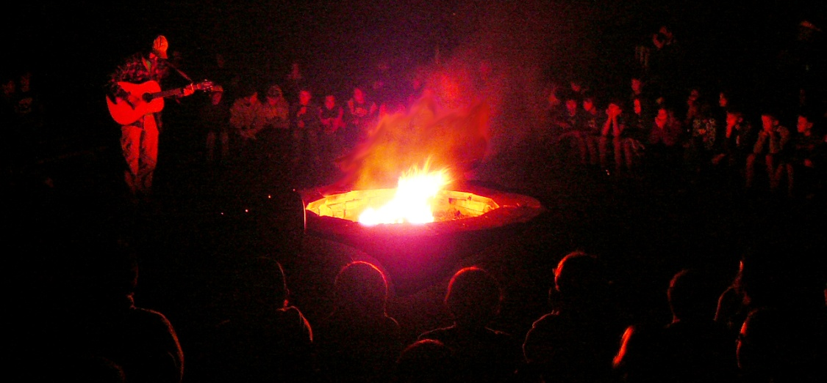
Evening Classes
Campfire
Historic Campfire
Night Hike
Sensory Awareness
Snakes
Raptors
Native American Games
Museum Tour

Slide 7
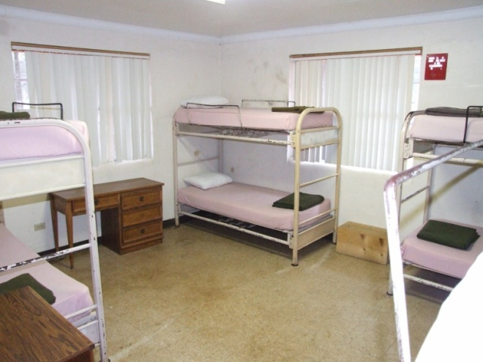
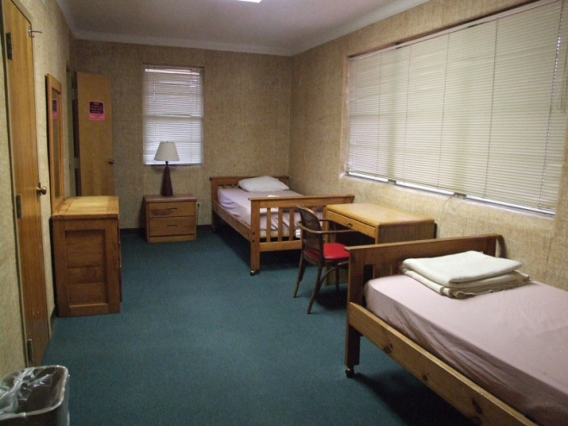
Traditional Cabins
Rock Eagle cabins sleep 22 people per cabin.

Slide 8
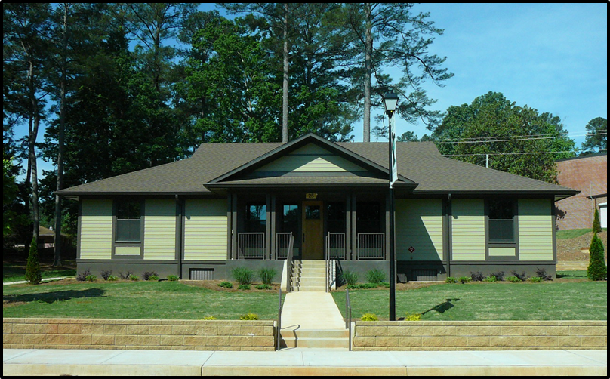
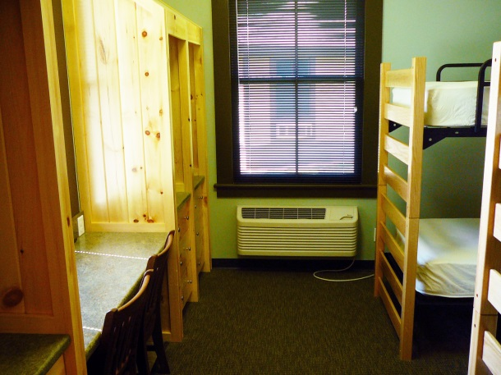
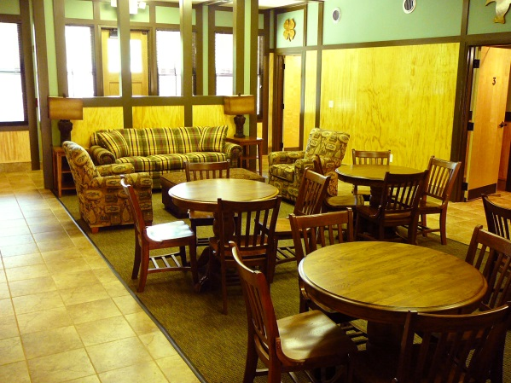
New Cabins
Rock Eagle cabins sleep 22 people per cabin.

Slide 9
The Facilities
Every group gets a home building.
Bathrooms
Water Fountain
Heat/ Air Conditioning
LCD/ PA System Available
Meeting Space
WiFi

Slide 10
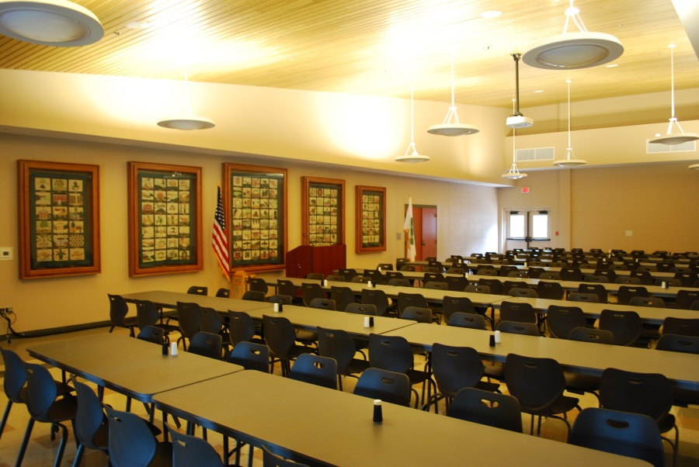
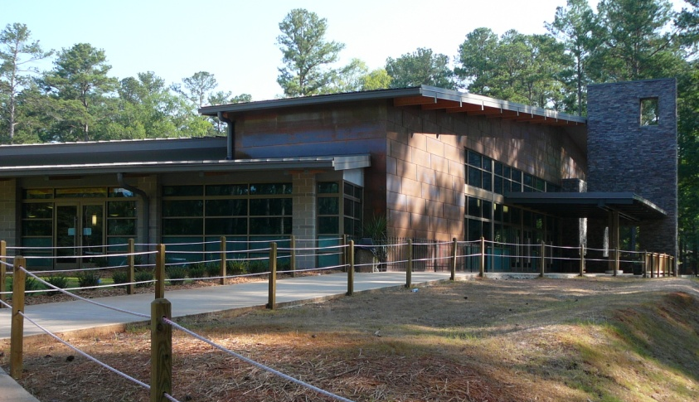
The Dining Hall
Every school gets a home building.
Rock Eagle is able to accommodate most dietary restrictions with advance notice.

Slide 11
The Staff
Each have a Four Year Degree.
Multi-Cultural from Across the World.
Criminal Background Checked.
Well Trained.

Slide 12
We look forward to seeing you…
at the Rock!
www.rockeagle4h.org/ee

